Slide 2

SPECIES RECOGNITION
FROM POLLEN IMAGE
VU THANH HANG – 20224310
NGUYEN HA ANH - 20224298

Slide 3
CONTENTS
Introduction
Method
Dataset
Experiment & Result
Conclusion & Future Work

Slide 4
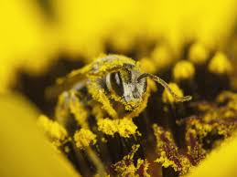
Introduction
Desired outcome
Input : pollen image
Output : species name
Challenges
Variety of pollen, similar feature
Limited labeled data compare to other image type
Noisy image

Slide 5
Method
Data augmentation
DenseNet121

Slide 6
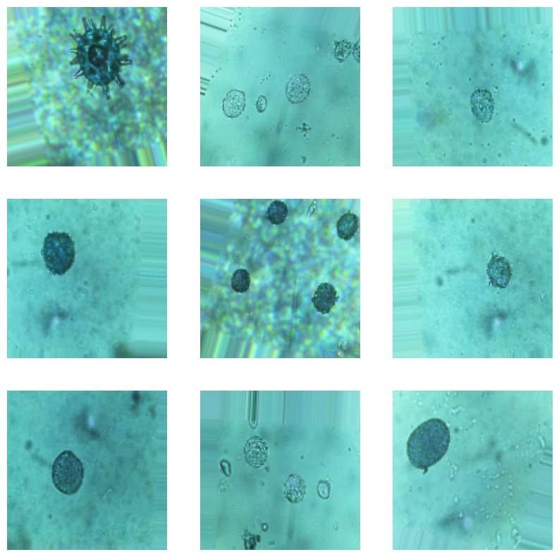
Method
Data augmentation
Generating new training images by applying transformations to existing ones (rotation, flipping…)

Slide 7
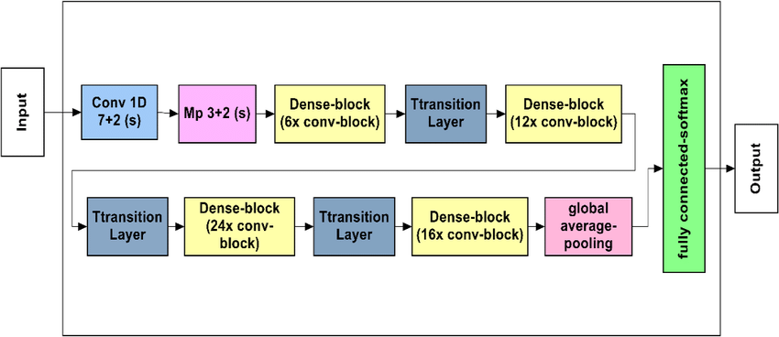
Method
DenseNet121
DenseBlock gets input from all previous layers
High performance with limited computational resources & small dataset

Slide 8
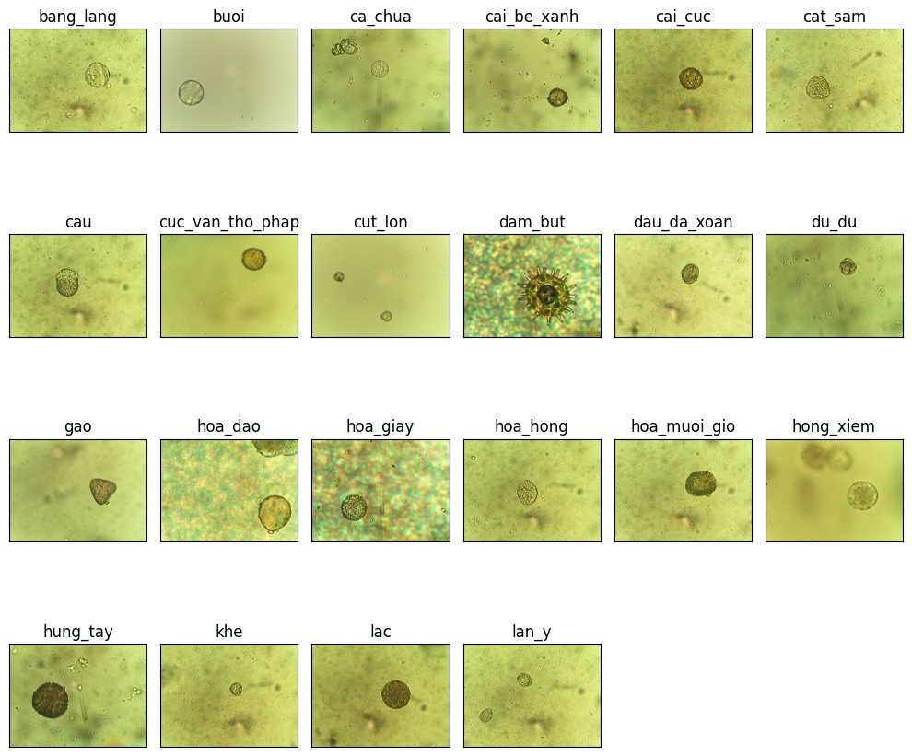
Dataset
Dataset
Pollen_VNUA subset
A dataset created by Vietnam National University of Agriculture
Subset of 22 species

Slide 9
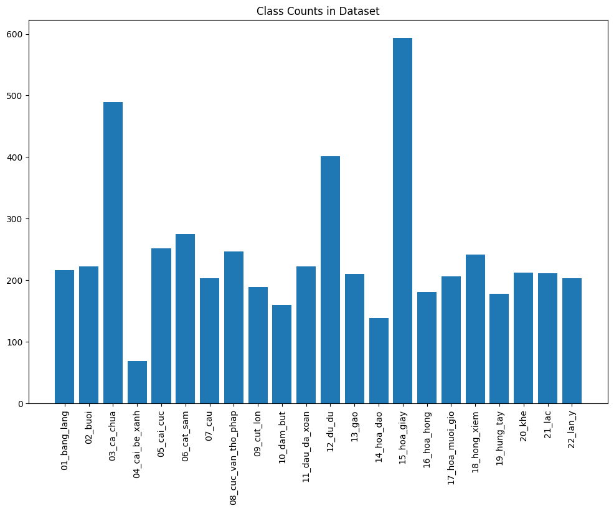
Dataset
Dataset
Highest: hoa giay
Lowest: cai be xanh
Total: 5322 images

Slide 10
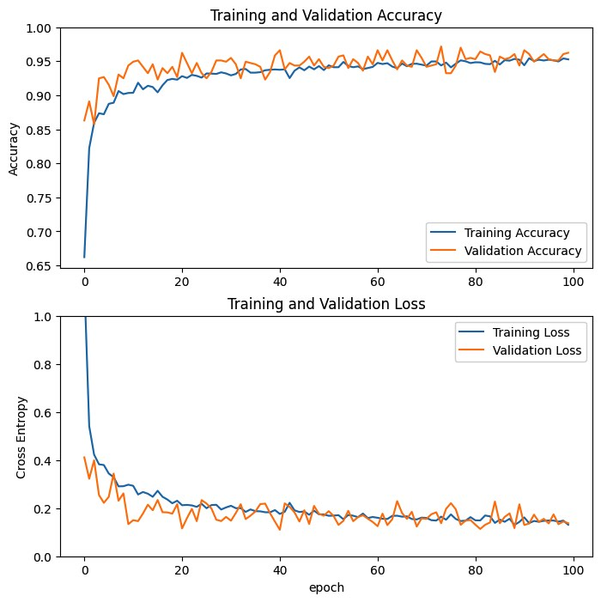
Experiment
Input image size 224 × 224: standard size
Accuracy on Test set ~97%

Slide 11
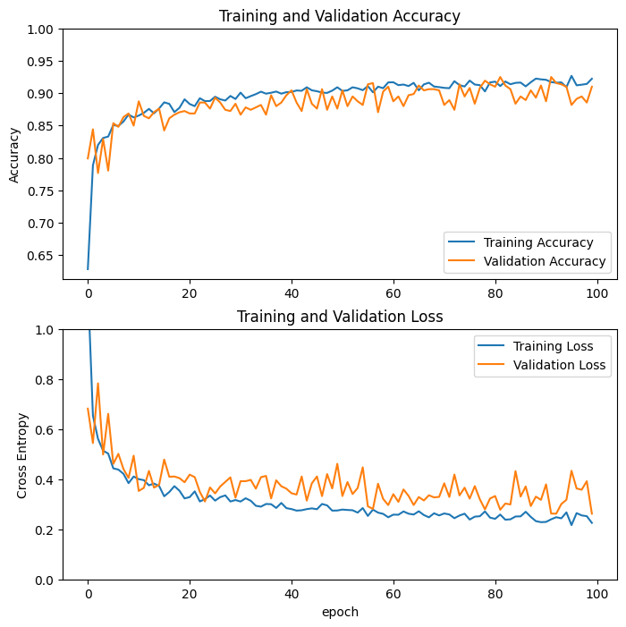
Experiment
Input image size 128 × 128: standard size
Accuracy on Test set ~93%

Slide 12
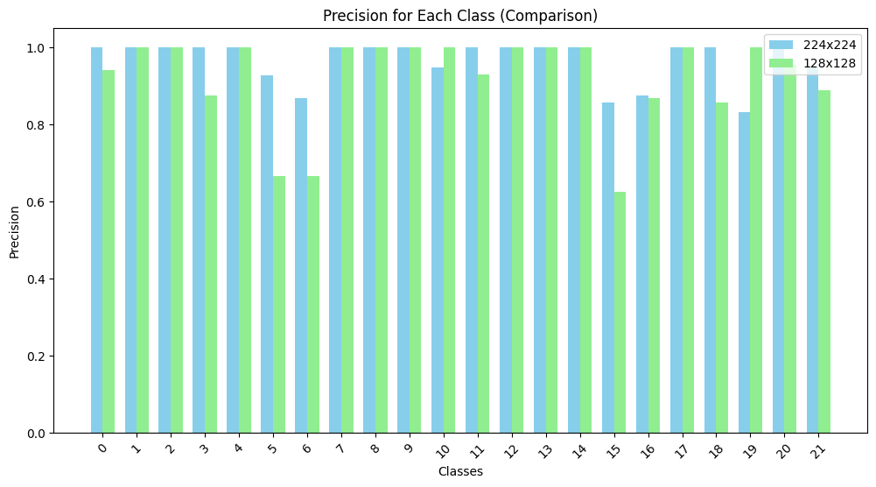
Experiment
Comparison of 2 input size

Slide 13
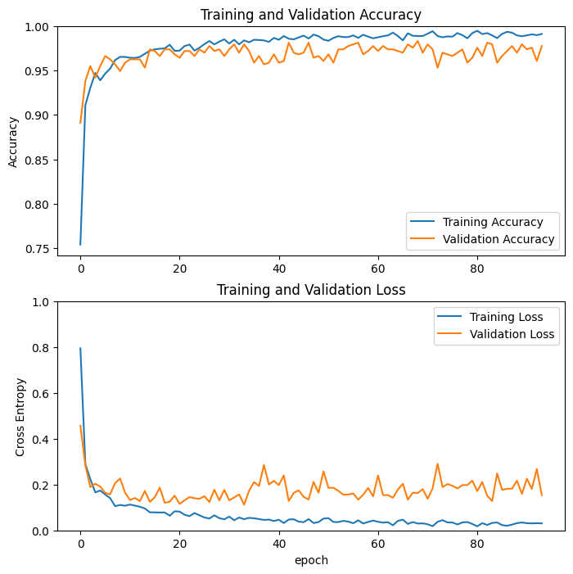
Experiment
Without data augmentation
Accuracy on Test set ~96%

Slide 14
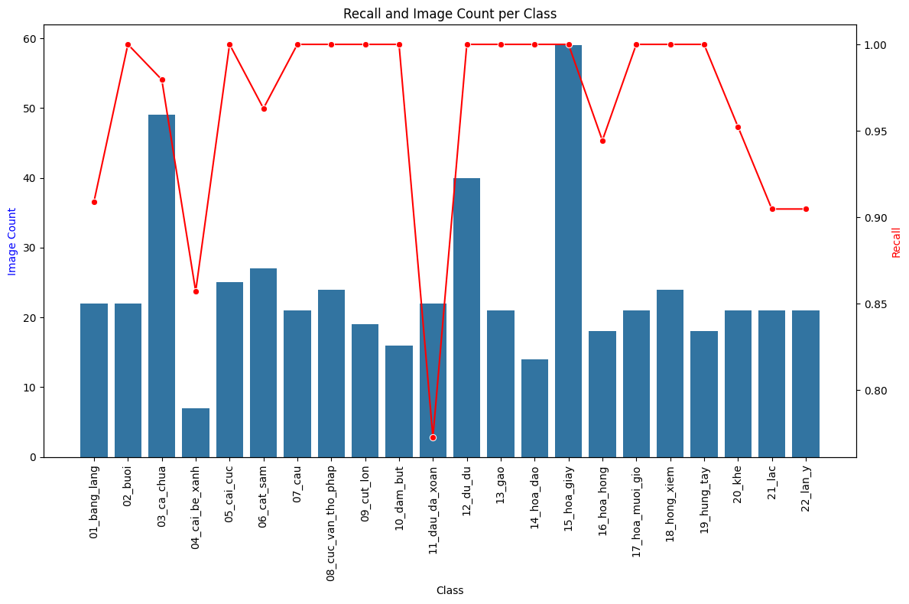
Experiment
Analysis on model with standard input size and data augmentation
Cai_be_xanh and dau_da_ xoan have low recall
For cai_be_xanh: lack of sufficient image data
For dau_da_xoan: may be caused by the class sharing visual features with other classes

Slide 15
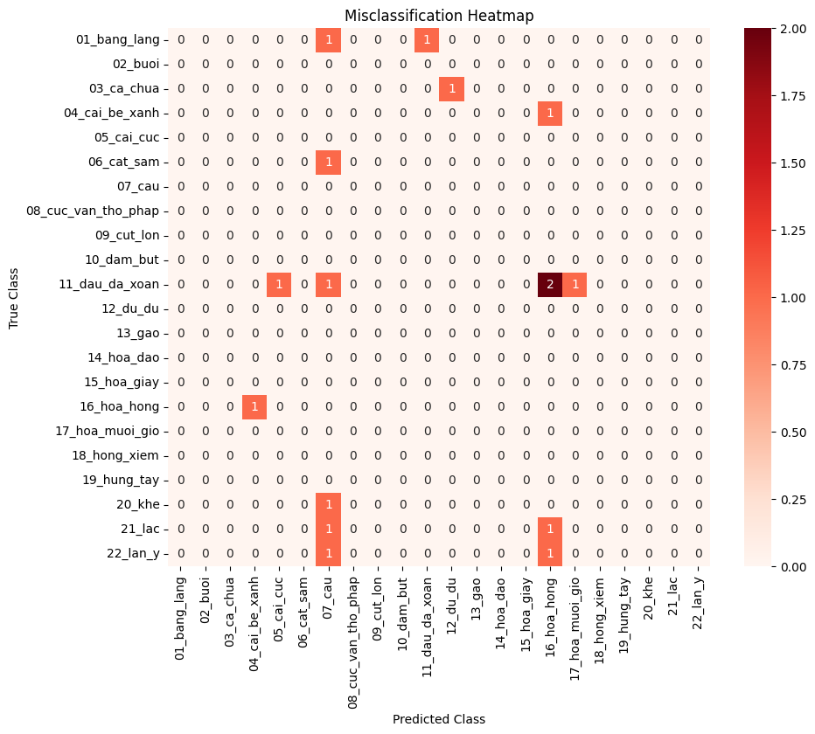
Experiment
Analysis on model with standard input size and data augmentation
Dau_da_xoan is often being misclassified as hoa_hong (twice), cau and other classes.
cau tends to receive misclassifications from other classes but it isn’t misclassified itself. -> cau might have more generic features that the model uses when uncertain

Slide 16
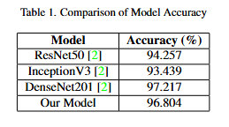
Experiment
Analysis on model with standard input size and data augmentation
Compare the model with other models' performance in the paper: [2]Pollen grain classification using some convolutional neural network architectures.

Slide 17
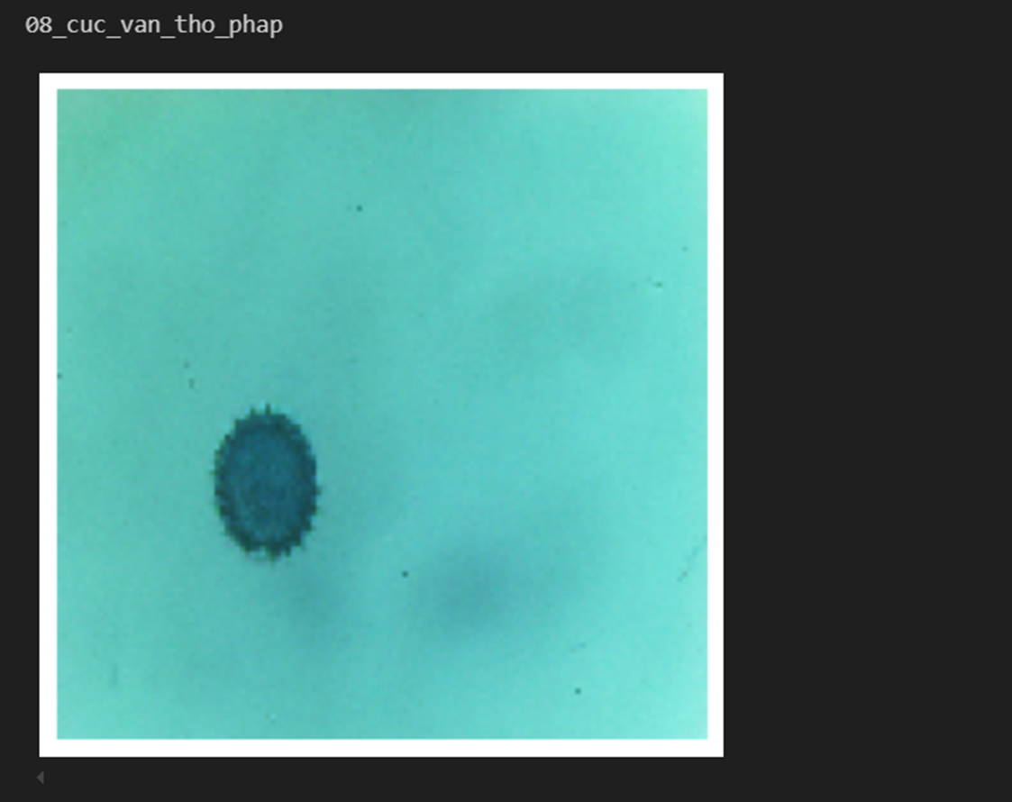
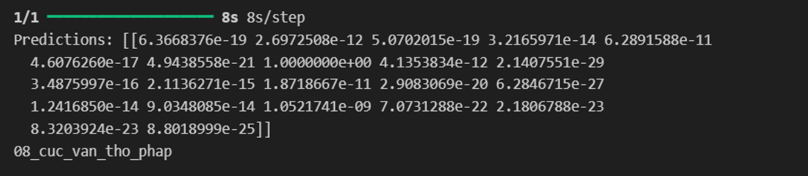
Experiment Result
Input in test set
Output of model

Slide 18
Conclusion & Future work
Project achievement
Developed an automated system for classifying pollen species using DenseNet121 and transfer learning.
Achieved 97% test accuracy despite limited data and inter-class similarity.
Optimized with data augmentation and dropout to prevent overfitting.
Future Work
Enhance preprocessing by isolating pollen grains and addressing noise.
Experiment with different architectures and hyperparameters to improve robustness.

Slide 19
References
[1] Gonc¸alves AB, Souza JS, Silva GGd, Cereda MP,Pott A, Naka MH, and Pistori H. Feature extrac-tion and machine learning for the classification ofbrazilian savannah pollen grains. PLOS ONE, 2016.doi:https://doi.org/10.1371/journal.pone.0157044. 1
[2] Benjamin Garga, Hamadjam Abboubakar, Rodrigue Saoun-goumi Sourpele, David Libouga Li Gwet, and LaurentBitjoka. Pollen grain classification using some convolutional neural network architectures. J. Imaging, 2024.doi:https://doi.org/10.3390/jimaging10070158. 2, 5
[3] Anna Geraci, Vincenza Polizzano, Pasquale Marino, andRosario Schicchi. Investigation on the pollen mor-phology of traditional cultivars of prunus species insicily. Acta Societatis Botanicorum Poloniae, 2012.doi:https://doi.org/10.5586/asbp.2012.017. 1
[4] Gao Huang, Zhuang Liu, and Laurens van der Maaten.Densely connected convolutional networks. arXiv preprintarXiv:1608.06993, 2018. 2
[5] France I., A.W.G. Duller, Duller G.A.T., and Lamb H.F.A new approach to automated pollen analysis. QuaternaryScience Reviews, 2000. doi:https://doi.org/10.1016/s0277-3791(99)00021-9.

Slide 20
THANK YOU !

